Slide 1
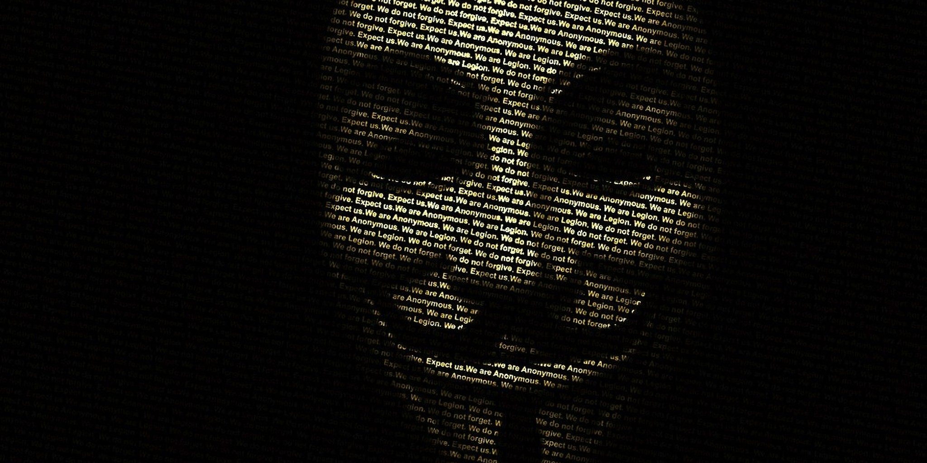
Not so Anonymous - Deanonymization of Blockchain Users
Johannes Ahlmann
Cork Blockchain Meetup
2018-11-13
https://www.dailydot.com/news/anonymous-opfullerton-kelly-thomas/

Slide 2

Lightning Talk - Agenda
Is Bitcoin anonymous?
What is Deanonymization?
Why should I care?
What can I do about it?
Where to get cryptos?
Alternatives

Slide 3
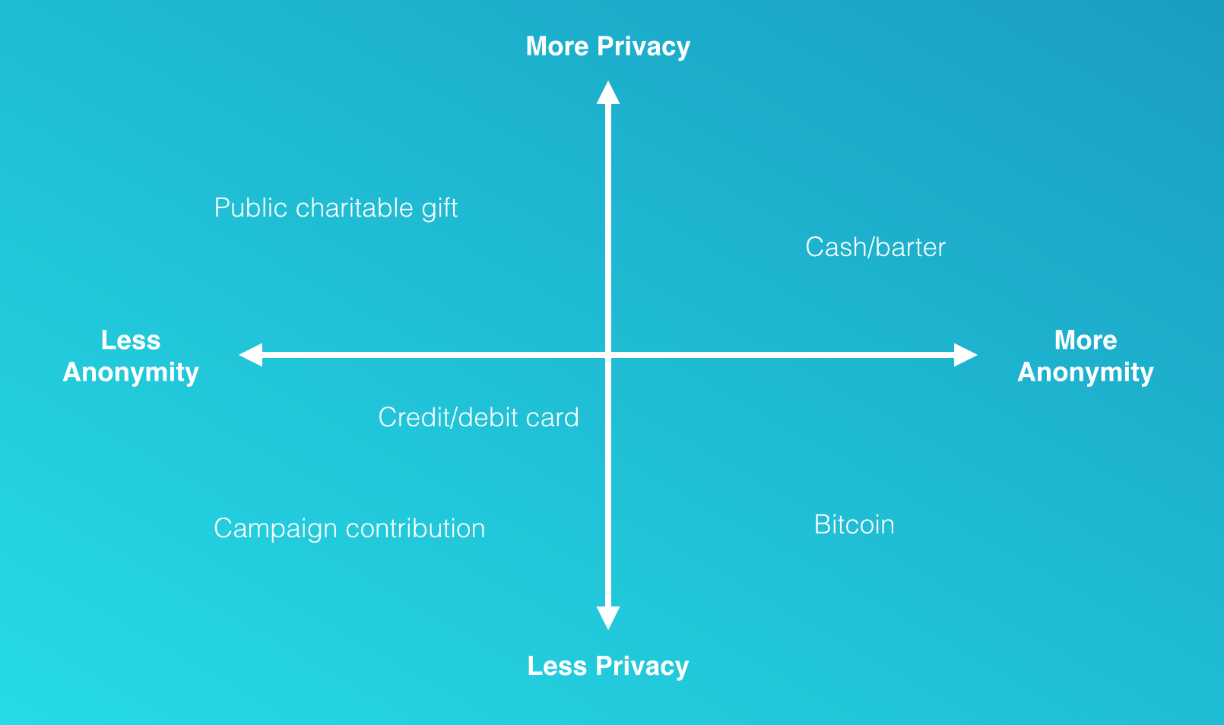
Anonymity & Privacy
Anonymity "They" can see what you do, but not who you are
Privacy
Controlling who sees what activities you engage in
https://d262ilb51hltx0.cloudfront.net/max/1610/1*d0KdwdeKDi5m8n-sZdr-_A.png

Slide 4

Anonymity 1/2
Pseudonymity - People are aware of one or multiple pseudonyms of yours, but not your true identity
Anonymity = Pseudonymity + Unlinkability
Unlinkability
Different actions of the same user should not be linkable to each other
Linking of addresses to users
Linking of transactions to users
Linking of senders to recipients
source: Prof. Murtuza Jadliwala

Slide 5

Anonymity 2/2
Privacy vs. Decentralization
Public Ledger is core component in consensus and sharing state of the world
Bitcoin is pseudonymous, not anonymous
public addresses = pseudonyms
much less anonymous, private than cash
Many Bitcoins are acquired through Exchanges or Mining Pools
Relatively few merchants/ market participants to trade with

Slide 6

What is Deanonymization
Linking you to your addresses
Linking you to your transactions
Tagging, clustering of totality of addresses, transactions
Approaches
Transaction Graph Analysis
Realtime Network Analysis of P2P network

Slide 7
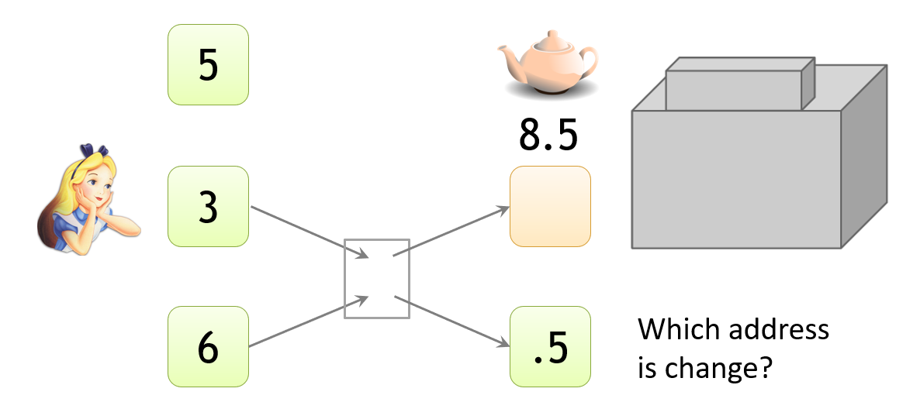
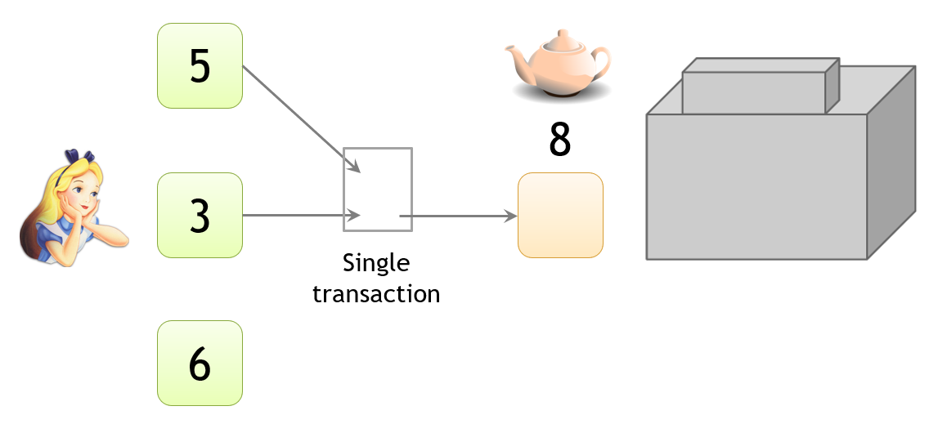
Transaction Graph Analysis 1/2
Change Address
Combined Addresses

Slide 8
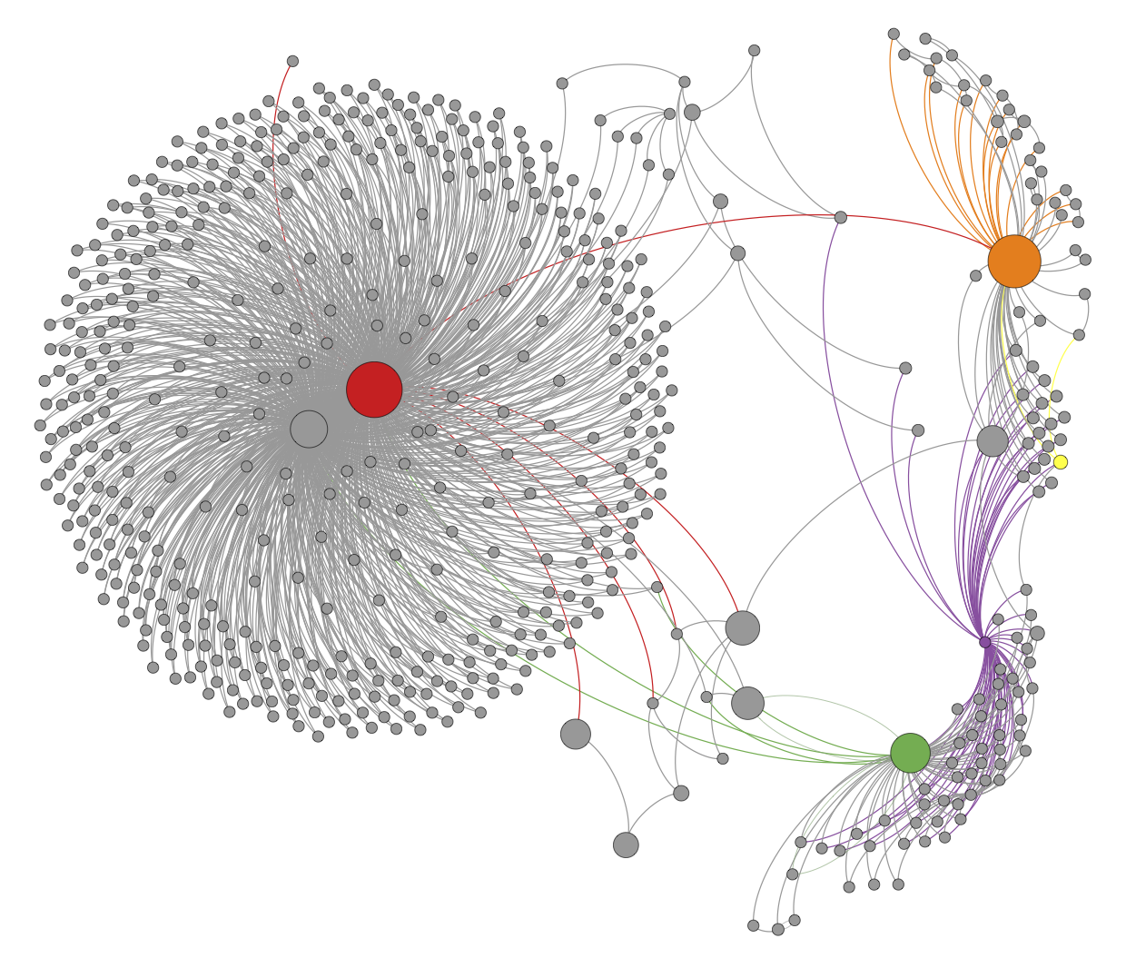
Transaction Graph Analysis 2/2
Bitcoin transactions are public
Active collecting
Mining pools
Online wallets
Exchanges
Merchants
Gambling
Tagging clusters
One tagged address in cluster tags all cluster
Bitcoin address should only be used once
An Analysis of Anonymity in the Bitcoin System
F. Reid and M. Harrigan, PASSAT 2011

Slide 9
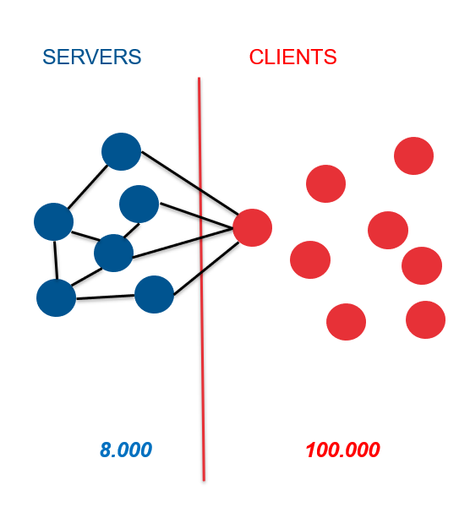
Realtime Network Analysis
"Attack" on the P2P Network
Peers distinguished over set of its (8) entry nodes
Linking inputs
Tagging clusters

Slide 10
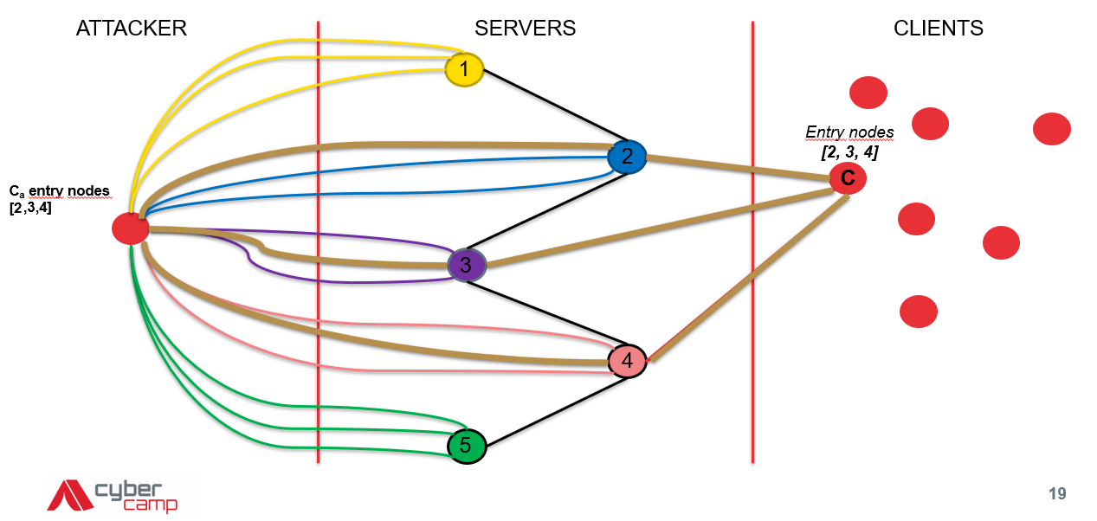
Learning Entry Nodes

Slide 11
Realtime Network Analysis
Linking of different transactions to same user
Each peer is trying to connect to 8 entry nodes
Network discovery
Servers
Receive incoming connections
Max. 117 incoming connections
Clients
8 outgoing connections
Peers are distinguished over set of it’s entry nodes!

Slide 12
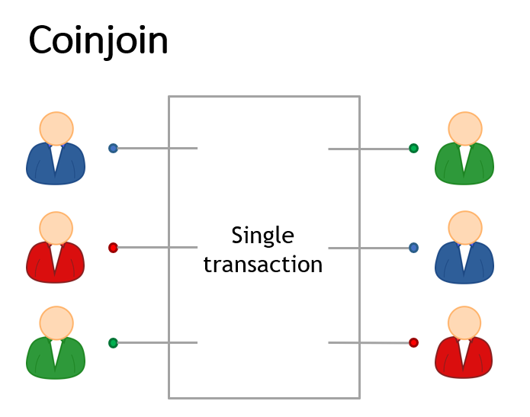
Remediation
Hierarchical Deterministic Wallets
Random Address Pool Wallets
Tor
Mixers
Who can we trust?
Coinjoin
How to find Peers?
Anonymous cryptocurrencies

Slide 13






Anonymous Currencies
Monero - Ring signatures
Dash - Fork of bitcoin, coin-mixing service
Zcash - zk-SNARK, zero knowledge proofs
Verge - Tor and I2P network for privacy
Komodo - Fork of Zcash, zk-SNARK
Pivx - Fork of Dash, Zerocoin protocol
(Legitimate goods vs. legitimate worries; how can this be used for good or bad?)

Slide 14
Thank You!

Slide 15
Resources
https://coincenter.org/entry/how-anonymous-is-bitcoin
https://bitcoinmagazine.com/articles/is-bitcoin-anonymous-a-complete-beginner-s-guide-1447875283/
https://www.coursera.org/lecture/cryptocurrency/how-to-de-anonymize-bitcoin-qnS76
https://www.slideshare.net/bhaslhofer/bitcoin-deanonymization-and-money-laundering-detection-strategies
https://pwlconf.org/2018/giulia-fanti/
https://www.technologyreview.com/s/608716/bitcoin-transactions-arent-as-anonymous-as-everyone-hoped/
https://decentralize.today/a-new-attack-vector-to-deanonymize-bitcoin-users-9c6dc433d4b6
https://www.deepdotweb.com/2017/04/20/how-companies-are-deanonymizing-bitcoin/
https://www.slideshare.net/bhaslhofer/bitcoin-deanonymization-and-money-laundering-detection-strategies
https://bitcoinsandblockchains.blogspot.com/2016/05/bitcoin-deanonymization.html
https://btcmanager.com/u-s-department-of-homeland-security-create-bitcoin-deanonymization-tool/
https://www.deepdotweb.com/2018/01/02/using-bitcoin-transaction-analysis-deanonymizing-users-tor-hidden-services/

